Slide 1

NeuroFleetX – AI Powered Urban Fleet & Traffic Intelligence
Infosys Virtual Intership 6.0
Presented By: Team B

Slide 2

Introduction
NeuroFleetX is an AI-powered system that enhances urban mobility through smart data and advanced analytics
Improves transportation efficiency with real-time traffic intelligence and route optimization
Supports fleet owners and cities by predicting congestion and automating fleet management operations
Creates a seamless, safe, and sustainable transportation environment for commuters and communities

Slide 3

Problem Statement
Urban mobility in rapidly growing cities faces serious challenges such as traffic congestion, inefficient fleet utilization, unpredictable travel times, and poor visibility into vehicle health
Without AI-driven insights, fleets often experience high fuel consumption, delayed services, increased maintenance costs, and reduced customer satisfaction.
These issues highlight the need for an integrated smart mobility solution that can optimize routes, monitor live vehicle performance, automate booking workflows, and improve overall operational efficiency

Slide 4

NeuroFleetX – AI-Driven Urban Mobility Optimization:
1.Development Phase Overview
2.Core Platform Setup
This phase focused on building the core system structure, essential modules, and the initial interface needed to operate NeuroFleetX effectively.
Configured the full-stack environment using React, Spring Boot, and MySQL. Established reusable components, routing, and database schema to support scalable development.
Backend API Development
Primary UI & Dashboard Design
Created key REST APIs for authentication, vehicles, bookings.Implemented structured controllers, validations, and secure data communication across modules
Developed the initial Dashboard, Vehicles, Bookings, and Maintenance pages with responsive layouts and pastel-themed UI design. Added basic interactions, smooth transitions, and intuitive navigation.

Slide 5

NeuroFleetX – Milestones:
01
02
03
04
Milestone 1 – Foundation Setup
Milestone 2 – Core Module
Milestone 3 – Feature Enhancements
Milestone 4 – Advanced Analytics Implementation
Learned Java, React, Spring Boot basics and built the initial login UI, API practice, and project environment setup.
Completed Authentication, Dashboard, Vehicles, Bookings with backend integration.
Developed Admin, Employee, and Customer dashboards with KPIs, charts, filters, tables, reusable components.
Added live tracking upgrades, booking validations, improved UI/UX.

Slide 6




Tech Stack:
Frontend
React,HTML,CSS,Tailwind/Bootstrap
Backend
Java ,Spring Boot for APIs
Database
MySql

Slide 7
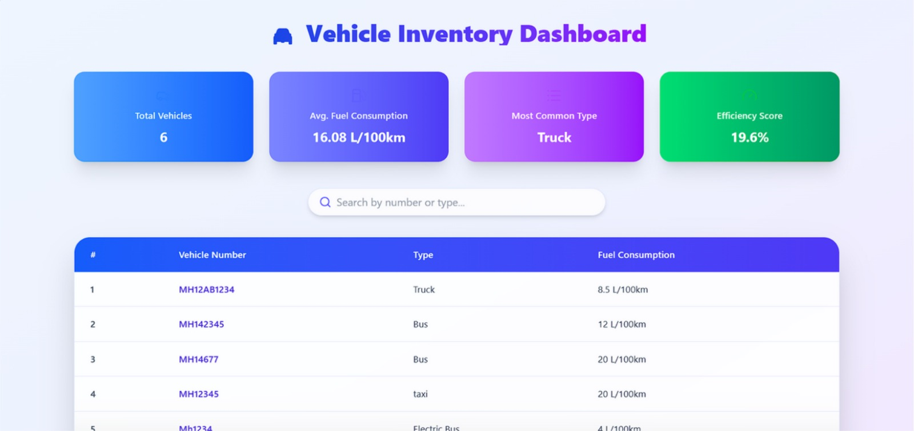
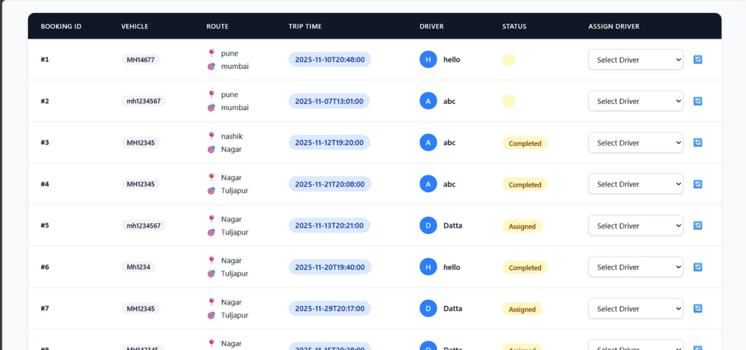
Admin Dashboard

Slide 8
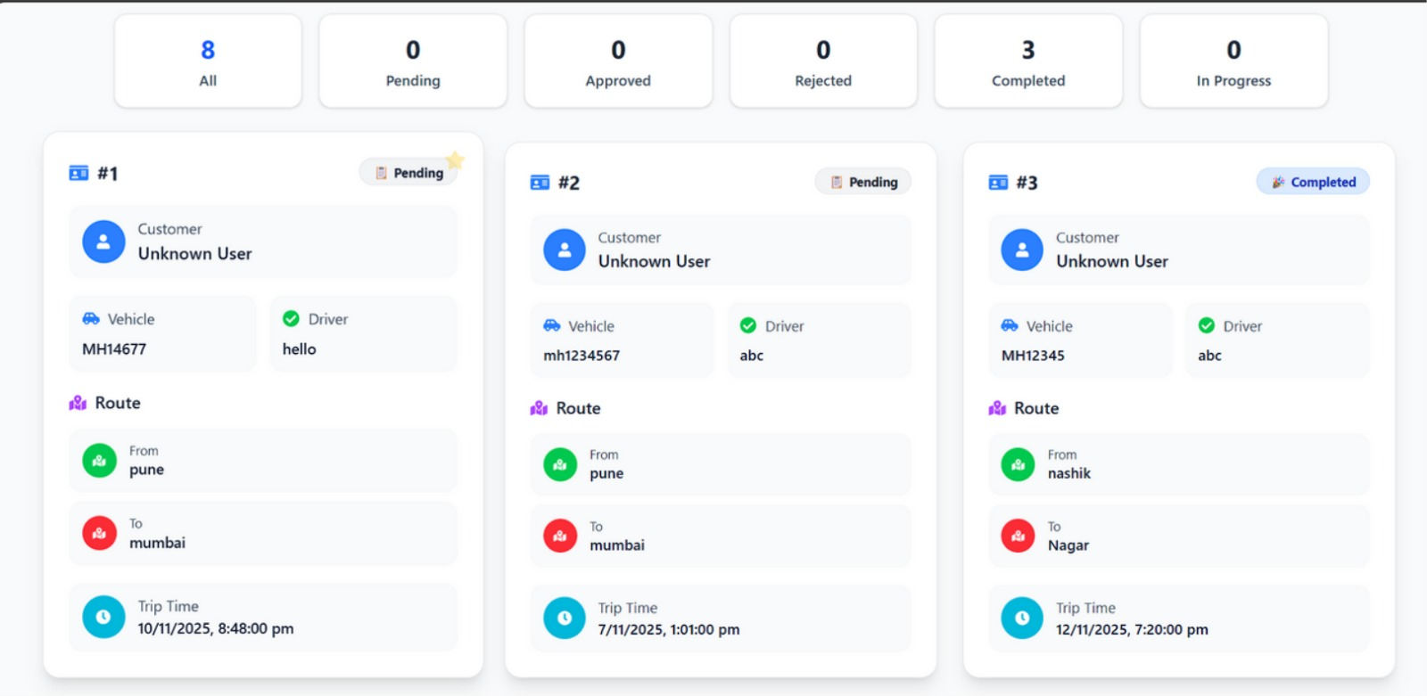
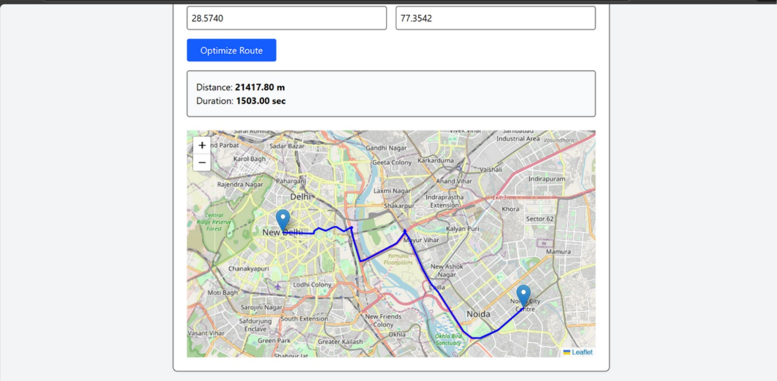
Customer Dashboard
Route Optimization

Slide 9
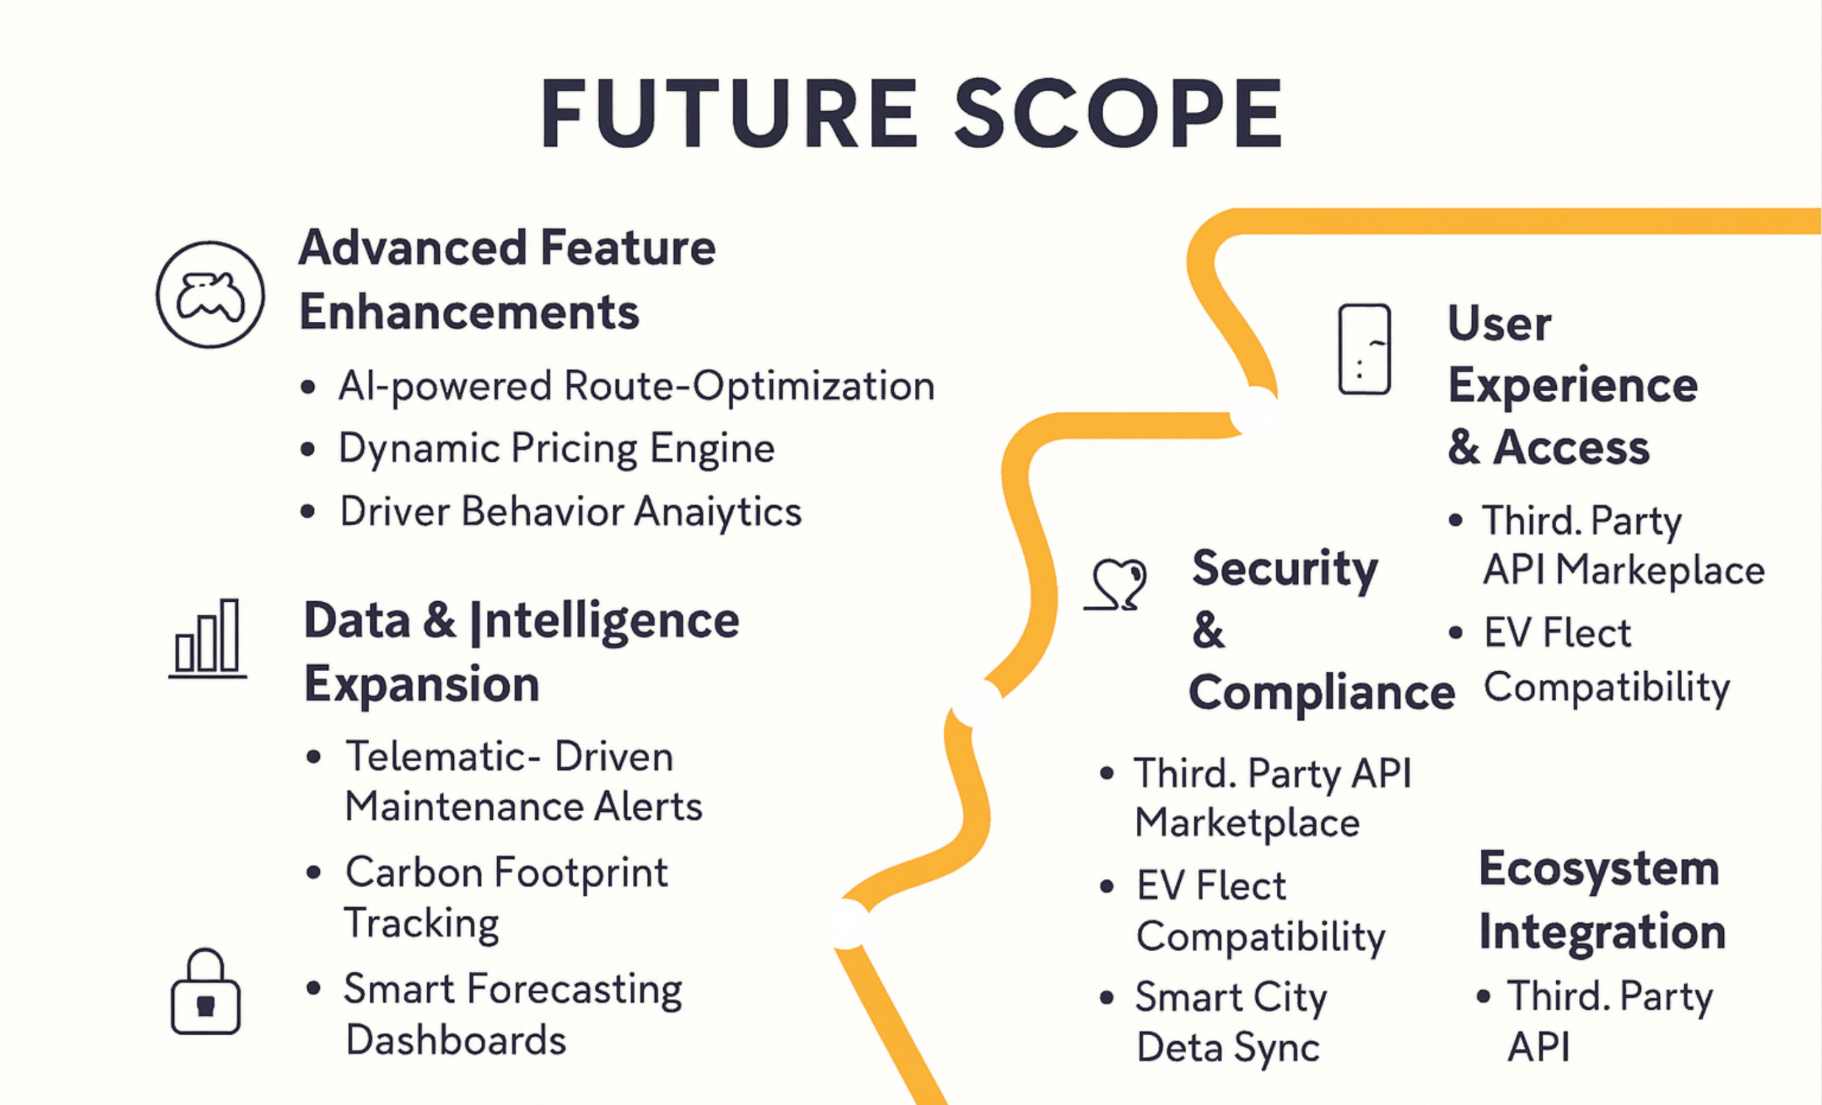

Slide 10



Conclusion
Built a smart, scalable fleet management system with a strong foundation, featuring role-based dashboards, real-time tracking, predictive analytics, and intelligent booking.
Focused on innovation, precision, and user-centric design, ensuring efficient, seamless, and reliable fleet operations.
Future roadmap prioritizes AI integration, data intelligence expansion, enhanced user experience, and advanced automation
Aiming to create a connected, sustainable, and high-performance fleet ecosystem through strategic partnerships and evolving intelligent technologies.

Slide 11
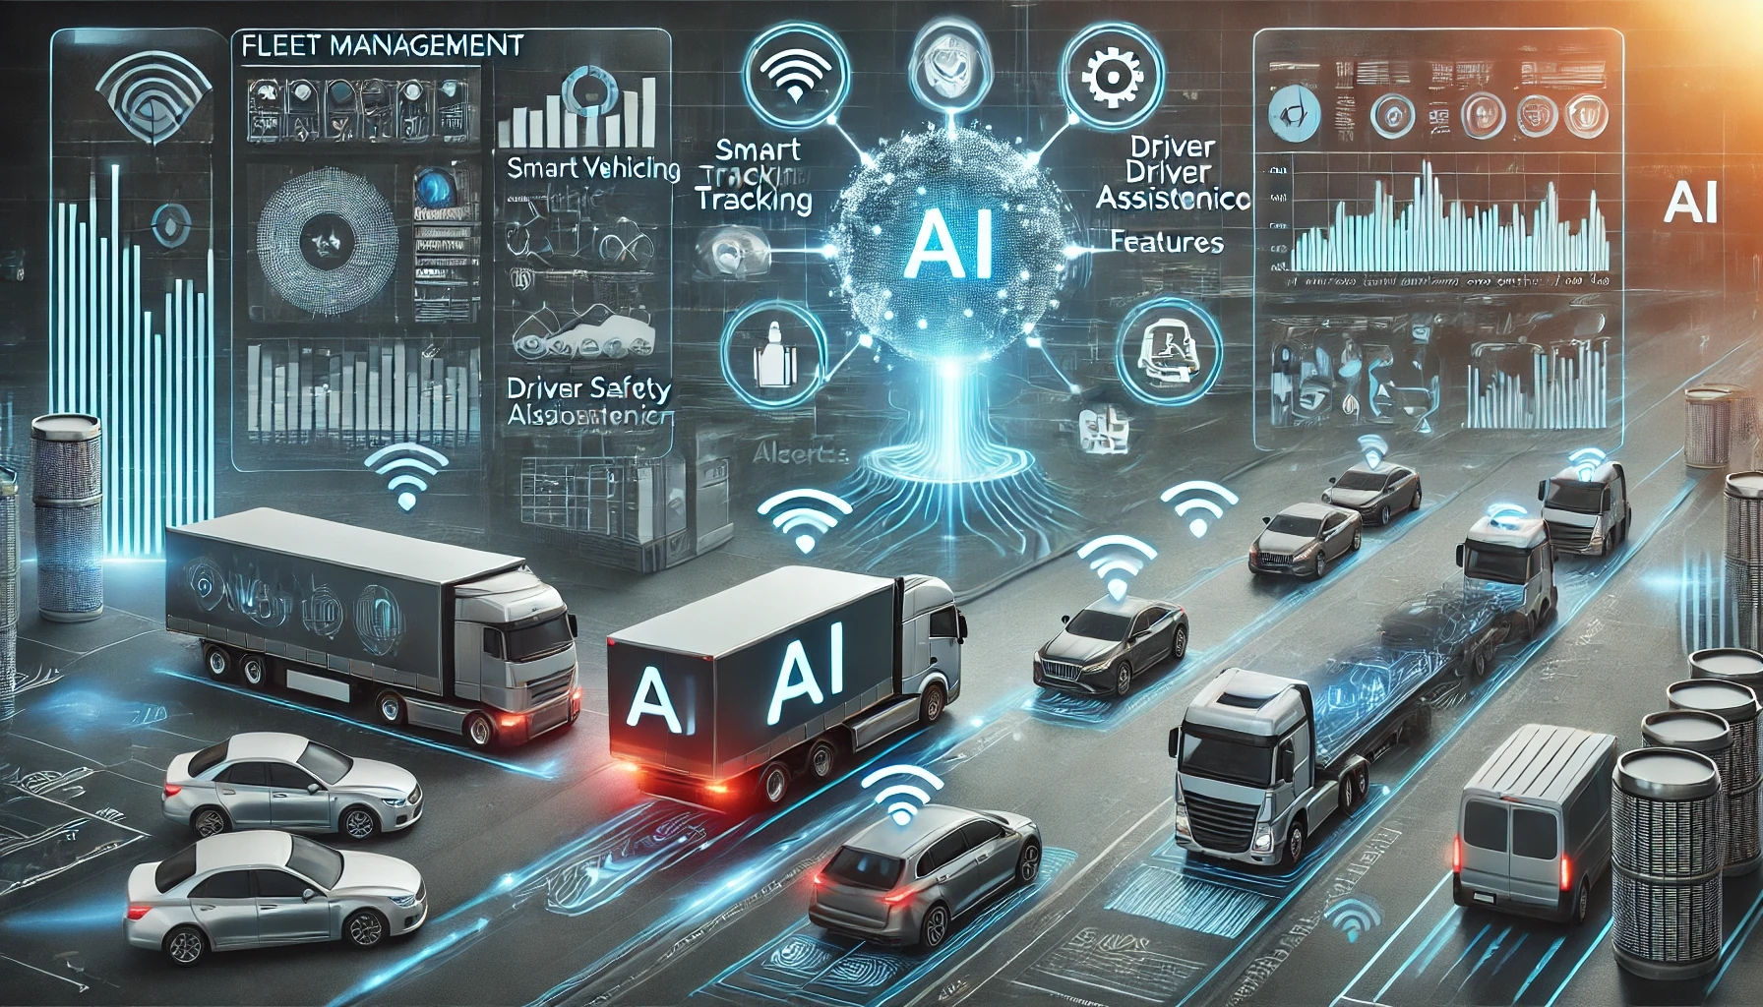
THANK YOU!

